Slide 1
Moreton Means Business
Engagement Event
24th April 2019

Slide 2
What are Neighbourhood Plans?
A community-led plan, which can help shape and influence future growth and development within an area
Sits alongside the Local Plan for the area, and can provide added detail and localised content
Once approved, decisions on planning in the area will be made with reference to both the Local Plan and the Neighbourhood Plan
The content must come from, and be approved by, the local community
Must be growth orientated – it cannot stop development, but it can help local areas shape future growth to be more sensitive to local needs, issues and opportunities

Slide 3
Moreton in Marsh Neighbourhood Plan [1]
A group of volunteers has established a Neighbourhood Plan Working Group, which is a sub-committee of the Town Council (who are body with responsibility for agreeing and submitting the final Plan)
Activity is based around 6 key themes, which are broadly in line with the UN Sustainable Development Goals:
A thriving low carbon environment that is resilient to a changing climate with clean and affordable energy for all
Good quality jobs and a thriving economy
Affordable housing that is fit for the future
Promoting sustainable transport
A vibrant and welcoming High Street and a town that maintains and enhances its unique character
Health, leisure and well-being for all ages

Slide 4
Moreton in Marsh Neighbourhood Plan [2]
Looking to engage and consult widely in this “issues & opportunities” phase
Further surveys and research work over the summer
Aim to draft report in the Autumn
Likely to be comprised of two parts – the planning policy section (the “core” Neighbourhood Plan); and a community projects/priorities section (the non-spatial planning part)
Second part linked to opportunities around the Community Infrastructure Levy

Slide 5
Planning & Economic Growth
Local Plans & Neighbourhood Plans should set out the vision and strategy for economic growth in the area over a significant period of time (10-20 years)
In general, the planning system can:
Enable growth through the provision of sites and locations for new economic activity
Influence the type and nature of growth through enabling or preventing certain uses on sites/areas
Facilitate growth by making it easier to do certain things in certain areas (Local Development Orders / Neighbourhood Development Orders)

Slide 6
Use Class Orders
Use Class |  | Allowed uses
A1 | Shops | Shops, retail warehouses, post offices, ticket and travel agencies, sale of cold food for consumption off premises, hairdressers, funeral directors, hire shops, dry cleaners, internet cafes
A2 | Finance & Professional Services | Banks, building societies, estate and employment agencies, professional services (not health or medical services).
A3 | Food & Drink | Restaurants and cafes
A4 | Drinking establishments | Public houses, wine bars or other drinking establishments.
A5 | Hot food takeaways | For the sale of hot food for consumption off the premises.
B1 | Business | Office other than a use within Class A2 Research and development of products or processes For any industrial process (which can be carried out in any residential area without causing detriment to the amenity of the area)
B2 | General Industry | Industrial process other than that falling within Class B1.
B8 | Storage or Distribution | Use for storage or as a distribution centre.

Slide 7
Use Class Orders
Use Class |  | Allowed uses
C1 | Hotels | Hotels, boarding and guest houses (where no significant element of care is provided).
C2 | Residential institutions | Residential accommodation and care to people in need of care, residential schools, colleges or training centres, hospitals, nursing homes.
C2a | Secure Residential Institutions | Prisons, young offenders’ institutions, detention centres, secure training centres, custody centres, short term holding centres, secure hospitals, secure local authority accommodation, military barracks.
C3 | Dwellinghouses | Use as a dwellinghouse (whether or not a main residence) by: a) A single person or by people to be regarded as forming a single household; b) Not more than six residents living together as a single household where care is provided for residents; or c) Not more than six residents living together as a single household where no care is provided to residents (other than use within Class C4).
C4 | Houses in multiple occupation | Use of a dwellinghouse by 3-6 residents as a ‘house in multiple occupation’ (HMO)
D1 | Non-residential institutions | Clinics, health centres, creches, day nurseries, schools, nonresidential education and training centres, museums, public libraries, public halls, exhibition halls, places of worship, law courts.
D2 | Assembly & Leisure | Cinemas, concert halls, bingo halls, dance halls, swimming baths, skating rinks, gymnasiums, other areas for indoor and outdoor sports or recreations not involving motorised vehicles or firearms.

Slide 8
Cotswold District Local Plan (2011-2031)
Adopted in August 2018
Sets out expected population and employment growth in the district over the 20 year period
Objectively Assessed Need on housing and employment land requirements
Identifies Moreton in Marsh as a “principal settlement”, and the main service centre for the North of the Cotswolds
Growth to be predominantly concentrated in the main towns and larger villages
The District’s economy seen as strong and resilient, but requires in-commuting from other areas due to tight labour market and ageing population
Tourism is a key sector and growing, but recognised that if not managed correctly could have an adverse impact on the environment and residents

Slide 9
Cotswold District Local Plan (2011-2031)
Policies relating to Economic Development
Range of policies that cover the following:
EC1: Employment Development – supporting activity that helps create new jobs within the District
EC2: Safeguarding of Existing Sites – protecting existing employment sites for B class use, and enabling intensification of activity
EC3: All-types of employment generating uses permitted in principle if within Development Boundaries; outside small-scale, appropriate development allowed
EC4: Special Policies [includes Moreton in Marsh Fire College]
EC5 & EC6: Rural Diversification and conversion of rural buildings –allowed if doesn’t conflict with existing operation of farm/agricultural activity, existing buildings re-used wherever possible, and in keeping with character of the area
EC7/EC8/EC9: Retail and Town Centre uses – follows retail hierarchy. Retail should in general be contained within the identified centres first, then edge of centre, then out of centre. Should be consistent with strategy for area, help maintain a mix of uses, and contribute to quality & attractiveness of centre. Out of town retail will be subject to assessments on impact on health of centre
EC10 & EC11: Tourism – new attractions permitted if have a functional relationship to historic or natural environment; well related to key tourist routes and meeting identified need/gap. New accommodation only allowed through use of existing buildings, no new build unless in exceptional circumstances

Slide 10
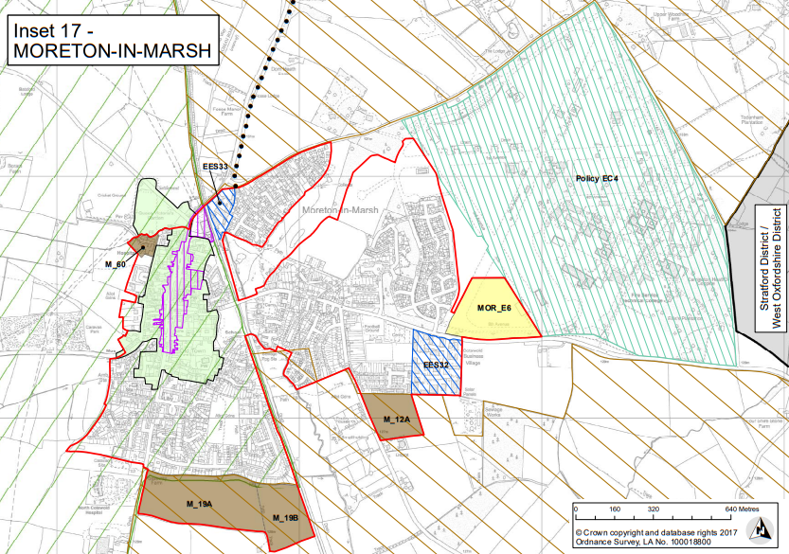
Moreton in Marsh (Policy S18)
Existing Employment Land
Fire College Site: Proposals for development of operational fire, rescue and emergency responders' training facilities, ancillary development, and associated infrastructure, will be permitted
Key Centre Boundary
New Employment Land (B1 use)

Slide 11
What can Neighbourhood Plans do..?
Retail/Leisure/Town Centres
Protection of retail spaces - making it harder to enable change of use
Encourage wider range of uses (encouraging certain uses/discouraging others)
Support for additional retail space
Enable temporary use of units to try and ensure units do not remain empty
Expand town centre boundary
Design codes for signage/street furniture to improve attractiveness of centre
Improving pedestrian flows through centre / better signage
Provision of additional office space / business hubs / shared working facilities

Slide 12
What can Neighbourhood Plans do..?
Tourism & leisure
Protection of existing accommodation / encouraging more accommodation / limiting additional accommodation
Rural diversification / redevelopment of agricultural buildings for accommodation
Support for tourist attractions in town
Improved transport transitions (public transport hub)
Walking and cycling routes (within and outside town)
Better signage and information
Support for additional leisure facilities within the town

Slide 13
What can Neighbourhood Plans do..?
Employment/business
Support redevelopment/intensification of existing employment sites
Increase / reduce flexibility on different uses
Provide forward guidance on expected uses of new employment sites / work with agents/partners to promote certain uses
Affordable employment space (start-up units, grow-on space, creative workshops, etc.)
Reduce costs of planning through Neighbourhood Development Order for new employment sites
Provision of sustainable transport links & facilities to new/existing sites
Design code / environmental requirements / screening
Support/encourage home working; requirement on space and broadband provision in new homes

Slide 14
Any questions..?

