Slide 1
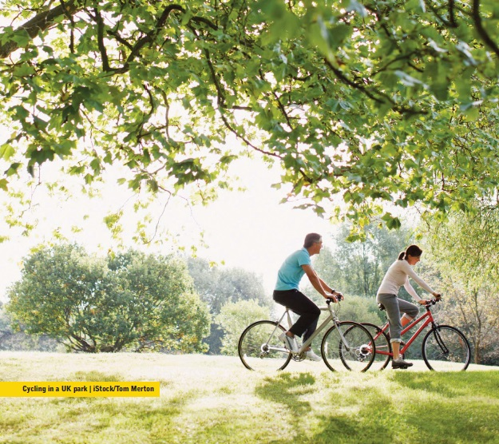
Neighbourhood planning for a safe and stable climate – Context of climate change: impacts, risks and legislation

Slide 2
Purpose of workshop, to:
Understand the full significance of climate change and scale of changes we need to take as a society
Consider how these relate to your community and how your neighbourhood plan might contribute
Consider how these relate to your community and how your neighbourhood plan might contribute

Slide 3
Workshop outputs:
An initial list of high level policy objectives for possible inclusion within your neighbourhood plan
A list of possible community actions and initiatives which might sit alongside your neighbourhood plan
An action plan, setting out next steps and allocating actions to individuals within your group and dates

Slide 4
Overview
6:30 | Arrivals – and tea and coffee
7:00 | Welcome, introduction and ground rules
7:10 | Presentation – Context of climate change
7:25 | Workshop set up
7:35 | Workshop – setting objectives
8:10 | Reviewing objectives
8:20 | Comparison with CSE’s suggested list
8:30 | Coffee / tea break (and reflection opportunity)
8:40 | Finalisation of objectives + what can be done through planning
8:50 | Agreeing next Steps
9:00 | Close

Slide 5
Neighbourhood Plan
Once adopted, neighbourhood plan policies have the same importance as your council’s planning policies.
Basic Conditions. That the neighbourhood plan:
Contributes to the achievement of sustainable development
Is in general conformity with the strategic policies contained in the development plan
Does not breach EU obligations
Notes:
Neighbourhood plans enable communities to set their own planning policies to control development which happens within their areas. Once adopted, these policies have the same importance as those set by your council.
There are no particular requirements that neighbourhood plans have to include, but they do have to comply with some basic conditions.
Neighbourhood plans are therefore a huge opportunity for communities to develop policies and strategies addressing climate change, to add to or fill gaps in what local council’s are already doing.

Slide 6
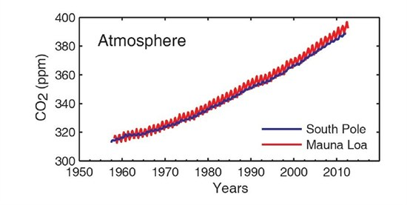
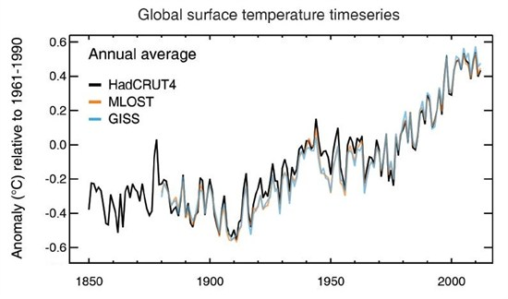
So why a “sustainable” Neighbourhood Plan?
Link: http://bit.ly/1C0wE5v
Notes:
The graph on the top left shows rising levels of carbon dioxide in our atmosphere, and the graph on the right shows rising temperatures.
So far there has been approximately a 1 degree warming globally since pre-industrial times.
In 2013 global CO2 levels passed 400 ppm. Levels of CO2 probably have not exceeded 400 ppm for 2 to 3 million years at which point the air temperature was up to 8 degrees C (14 degrees F) higher than today.
Sources:
http://www.worldviewofglobalwarming.org/pages/maunaloa.php
http://www.carbonbrief.org/blog/2013/09/ipcc-six-graphs-that-explain-how-the-climate-is-changing/

Slide 7
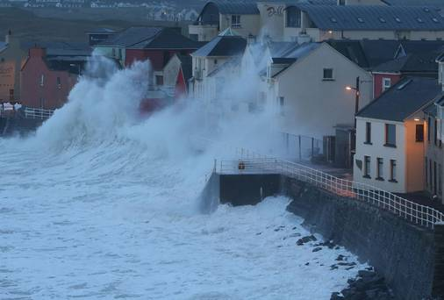
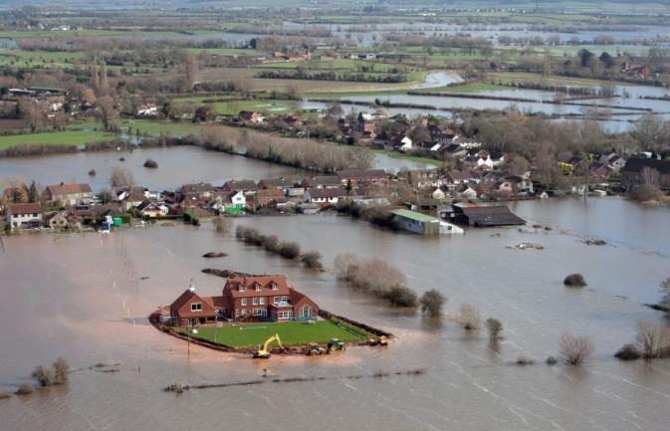
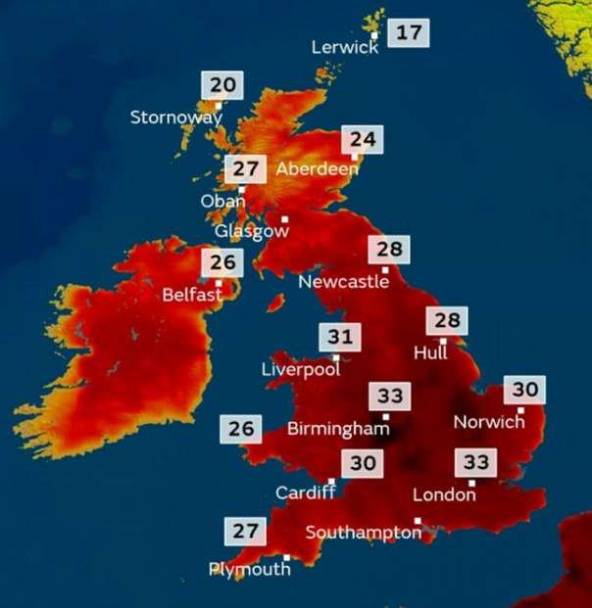
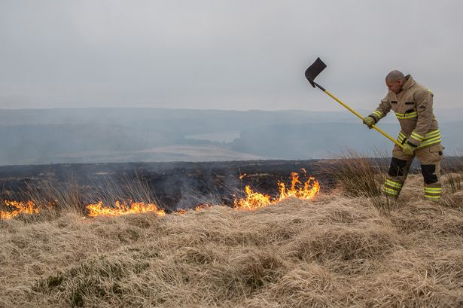
Uk climate impacts
Notes:
The predictions are that climate change will result in more extreme weather events: with more severe storms, flooding and heat waves, and wetter winters and drier summers, and we’re already seeing this each year. The heatwave this summer contributed to 600+ deaths.

Slide 8
Extreme weather events in the UK
2003 | Heatwave | 2012 | Drought Flooding
2004 | Boscastle Floods | 2013 | Hot weather Storms Flooding
2005 | Flooding in Cumbria & Carlisle | 2014 | Storms Flooding in Oxford & Somerset
2007 | Drought Floods in Oxford, Gloucestershire | 2015 | Winter Floods – Leeds, York, Carlisle, Cumbria
2007 | Flooding Heatwave | 2016 | Storm Desmond Winter Floods
2008 | Flooding Snow and Ice | 2017 | Floods
2009 | Flooding in Cockermouth Snow and Ice | 2018 | Heatwave, wildfires, The beast from the east
2010 | Flooding Snow and Ice | 2019 | Hottest winter day on record – 21 Degrees in February
Notes:
This slide shows the extreme weather events that have occurred in the uk since 2003, many of which you’ll recall, in particular the floods around the country. It’s not possible to say that individual weather events are caused by climate change, but it makes events like this much more likely.

Slide 9
When was the hottest year on record globally?
Link: http://bit.ly/1C0wE5v
Notes:
Ask this question to the group
- The hottest year on record was 2016
- previous hottest year on record – 2015
previous hottest year on record - 2014
previous hottest year on record - 2010
In fact, 16 of the 17 warmest years have occurred since 2000
https://www.nytimes.com/2017/01/18/science/earth-highest-temperature-record.html

Slide 10
Introduction - International / UK legislation
Paris Climate Change Accord – to limiting global temperatures increases “well below 2°C above pre-industrial levels, ideally 1.5 °C”
Climate Change Act – 80% reduction in greenhouse gas emissions by 2050
Notes:
There are two pieces of legislation around climate change:
The Paris Climate Accord commits nations to keep global average temperatures “well below 2°C above pre-industrial levels, to pursue efforts to limit the temperature increase to 1.5 °C”, leading to no net increases in carbon emissions in the second half of this century. It hasn’t been translated into UK legislation yet.
Climate Change Act – this commits the uk to reduce CO2 emissions by 80% by 2050 (from 1990 baseline) and sets in place transitional targets to achieve on the way to the overall target and a formal review mechanism.

Slide 11
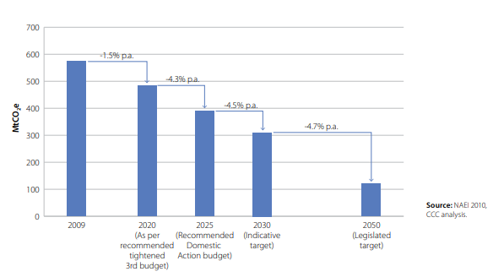
Introduction - International / UK legislation
Climate Change Act 2008 - commitment to reduce CO2 emissions by 80% by 2050
Notes:
This shows the legislated carbon reduction targets from the Climate Change Act, stepping down emissions from uk to 2050. Committee on climate change reports regularly and holds gov to account to achieve these cuts.

Slide 12
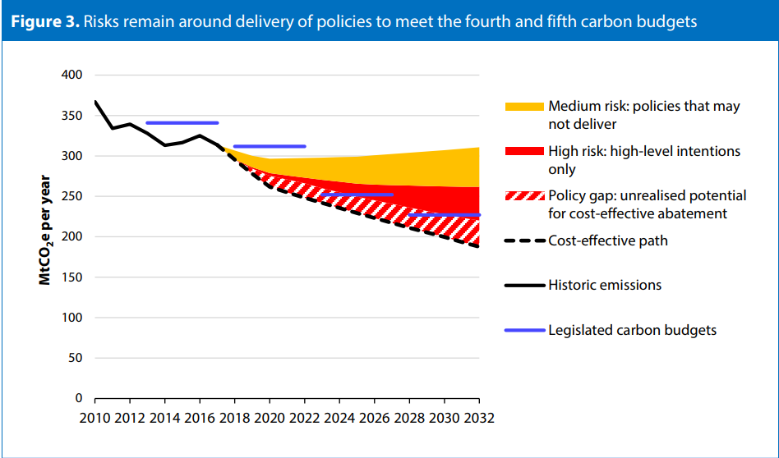
“The UK is not on course to meet the legally binding fourth and fifth carbon budgets.” Committee on climate change - 2018 Progress Report to Parliament
www.theccc.org.uk/wp-content/uploads/2018/06/CCC-2018-Progress-Report-to-Parliament.pdf
Notes:
This is an excerpt from the 2018 progress report to parliament, the Committee on Climate Change – It shows the likelihood of meeting our interim carbon reduction targets towards an overall 80% reduction. I won’t go through the detail, suffice to say we’re not on course to meet an 80% reduction by 2050.

Slide 13
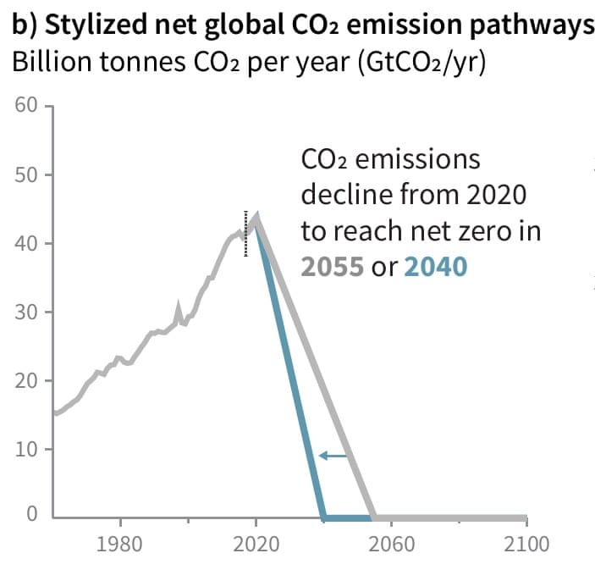
IPPC report 2018 - Global Warming of 1.5 ºC
There are only 12 years to keep global warming below 1.5°C.
Beyond this the risks of drought, floods, extreme heat and poverty for hundreds of millions of people will significantly worsen
www.ipcc.ch/site/assets/uploads/sites/2/2018/07/SR15_SPM_High_Res.pdf
Notes:
Historically, a temperature increase of 2°C has been seen as a benchmark to prevent climate catastrophe; however a recent report from the Intergovernmental Panel on Climate Change reveals the true dangers of a global temperature rise of 2°C, which are far worse than we thought.
There are only 12 years to keep global warming below 1.5°C, beyond this level of warming the risks of drought, floods, extreme heat and poverty for hundreds of millions of people will significantly worsen

Slide 14
IPPC report 2018 - Global Warming of 1.5 ºC
“The challenge of avoiding catastrophic climate breakdown requires rapid, far-reaching and unprecedented changes in all aspects of society”
Notes:
This is a very sobering quote from the report with what's needed.
There’s a couple of key takeaways:
Climate Change is happening faster and with more severe impacts than we thought.
We aren’t even meeting the carbon reduction targets we already have in place, and much faster reductions are needed.
So government needs all the help it can get.

Slide 15
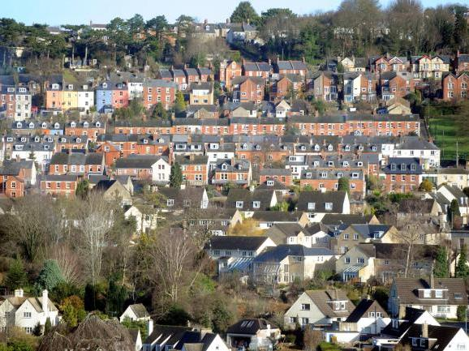
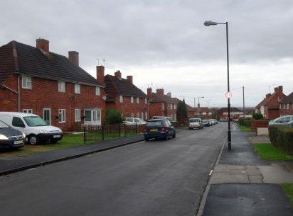
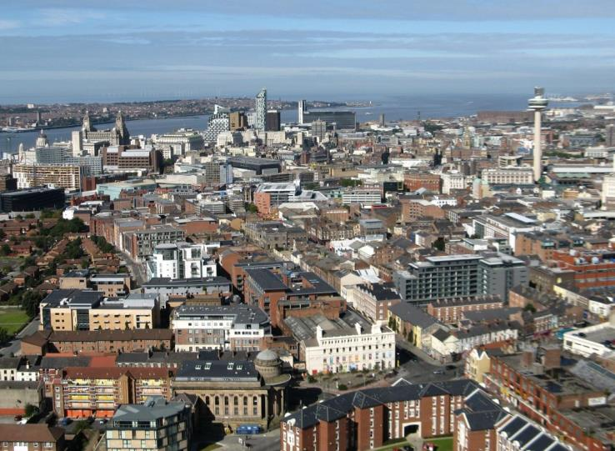
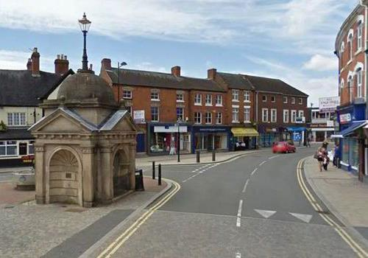
Workshop
Notes:
STOP HERE AND DIVIDE THE GROUP INTO 4 SUB-GROUPS. FOLLOW THE WORKSHOP INSTRUCTIONS ON SHEET PROVIDED.
Read this script to set up the workshop:
“Imagine its 2050. We have cut carbon emissions to nothing and have a stable climate. What have we done to our towns and cities to achieve this in the UK?
How have we adapted our towns and cities to reduce carbon emissions and how have we adapted to the impacts of climate change? What actions have we carried out and what policies do we have in place. Think about your town / village and how and where you live now:
How we generate electricity and heating
How we travel (and how much we travel)
The buildings we live + work in
Where we put housing
Where we put offices
Where we put shops
Please discuss amongst yourselves and write actions onto post-it notes, one post-it note per suggestion.”
Give 15 minutes for the groups to discuss amongst themselves, then collect the post-it notes theme by theme and transfer to a flip chart. Get attendees to group the post-it notes into themes, and suggest names for themes. Get the group to agree titles for each theme.
Ask whether there are any policies or actions missing and get the group to agree to the list they’re created and to the theme titles.
Next, title the flip chart “planning policies” and another flip chart “community actions” and ask the group to transfer to the second flip chart any actions or policies that you would bring about through systems and processes other than the planning system and decisions on planning applications.

Slide 16
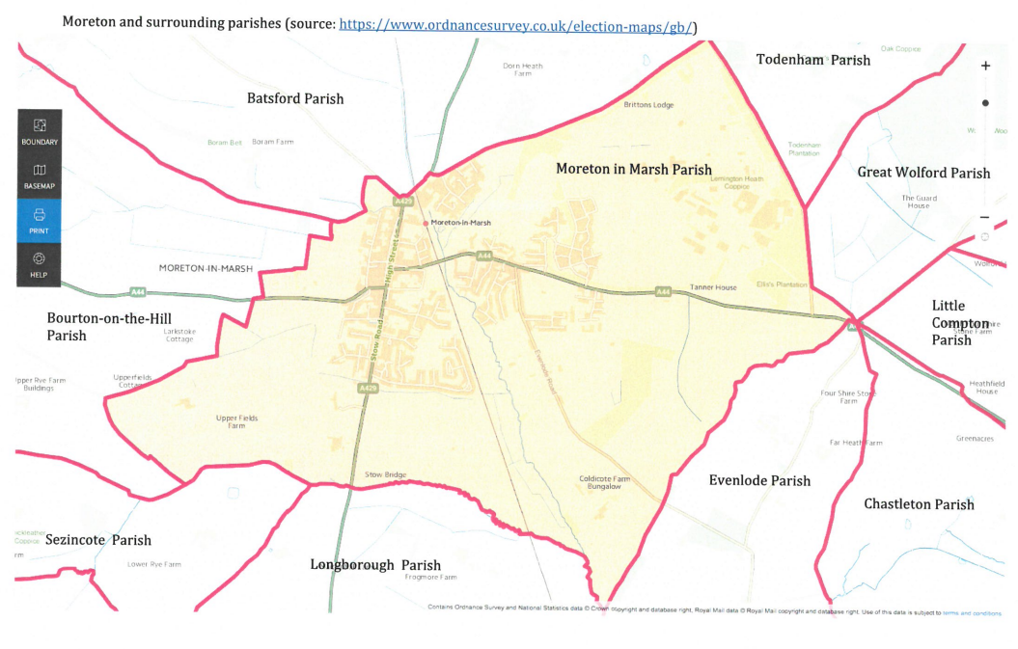

Slide 17
Workshop task
“Imagine its 2050. We have cut carbon emissions to nothing and have a safe stable climate. What have we done to achieve this?”
How have we adapted our town to reduce carbon emissions and how have we adapted to the impacts of climate change? What actions have we carried out and what policies do we have in place. Think about your town / village and how and where you live now:
How we generate electricity and heating
How we travel (and how much we travel)
The buildings we live + work in
Where we put housing, offices, shops and services
How we protect biodiversity
How we’ve adapted to extreme weather”
Notes:
Please put down your comments
You’ll see there’s 4 flipcharts dotted around the room
Energy (electricity and heating)
Resilience to extreme weather / protecting biodiversity
Our Buildings
Transport / service provision / location of development
Blank

Slide 18
Our Buildings | Transport, service provision / location of development
All new development to be zero carbon (highly energy efficient in construction, requiring little to no heating, with zero carbon emissions) | Sustainable patterns of development which minimise the need to travel – new development in locations accessible on foot, by bike and on public transport
Retrofit existing housing stock (e.g. historic buildings) to radically reduce energy use / carbon emissions and reduce fuel poverty, whilst protecting historic value | Safe /convenient walking and cycling routes in new development
Encourage sustainable design + construction in new development – e.g. minimise the use of energy + carbon intensive materials – steel, concrete, glass. | Removing barriers to cycling and walking (existing development)
All new development to maximise on-site energy generation from renewable sources (e.g. solar panels), with use of on-site electricity storage? | Decarbonise transport – new developments to provide electrical car charging points
Rainwater collection and recycling | Maximise local access to services employment + minimise travelling time
 | Measures to support and enable home working
 | Measures to safeguarding local shops + facilities and support local high street – to meet peoples needs near where they live
 | (Related issue) addressing air pollution in urban areas

Slide 19
Energy (electricity and heating) | Resilience to extreme weather / protecting biodiversity
Fossil fuels phased out - 100% of electricity from renewable energy sources - no new homes with gas for heating / cooking | Avoiding areas of future flood risk
Local renewable energy developments maximised – e.g. solar farms, micro hydro, onshore wind, anaerobic digestion. | All suitable development to have sustainable urban drainage systems to manage flooding and provide habitats for wildlife (also delivering cooling effects)
Where possible, community aims to provide all its own electricity from local renewable sources and to own some of its energy supply. | New development to achieve a net benefit in biodiversity and incorporate wildlife habitat
Smart houses incorporating battery or other energy storage to enable intermittent renewable electricity supply (e.g. from solar panels) to be stored to match demand | New developments to be resilient to overheating and heat stress
Stand-alone energy storage to maximise renewable energy potential | New development to incorporate green roofs and walls to manage flooding and heat stress (especially in urban areas)
Maximum exploitation of district heating systems in dense urban areas (District heating = communally provided heat, circulated through insulated underground pipes to multiple buildings) | Tree planting / landscaping in public spaces to manage heat stress (especially in urban areas)

Slide 20
Specific local issues + opportunities in Moreton in Marsh
Re-vitalising your town centre to meet people’s needs, support your local economy and local employment – e.g. food markets for local producers, making full use of town centre buildings (inc upper floors) for employment provision, townscape improvements
(Related) siting car charging infrastructure in town centre (powered by 100% renewables) to encourage thru traffic to stop (for at least 0.5 - 1 hr!)
Reclaiming your town centre from cars? Suggest use of demand management first (employing a warden), rather than simply increasing supply.
Diversifying your tourist offer
Making the most of your railway station (routes to and from it + signage)
Reducing out-commuting by car
Making the town pedestrian + cycle friendly
Providing more local employment?
Energy efficiency of your historic building stock
Onshore wind? An earlier workshop suggested there might be community support for this, provided sensitively sited and of appropriate scale.

Slide 21
what can and can’t you have influence over through planning - summary
What you can influence
What you can’t influence
Any situation involved the development or use of land where planning permission is needed
Where new buildings or uses that need planning permission can go
The design and layout of buildings including drainage
Transport implications of new development
Some infrastructure provision (e.g. cycle routes, bus stops etc) where linked to new development, or paid for by new development, and necessary in order to make the development acceptable
Developments which don’t need planning permission
Spending decisions or actions by other bodies
How existing buildings are used
The sale and disposal of land

Slide 22
Tea Break!

Slide 23
Discussion, Questions & Answers

Slide 25
Thank you
neighbourhoodplanning@cse.org.uk
www.cse.org.uk
@cse_bristol
0117 9341436 (direct) | 0117 9341400 (switchboard) | www.cse.org.uk
Centre for Sustainable Energy, 3 St Peter's Court, Bedminster Parade, Bristol, BS3 4AQ

